Slide 1
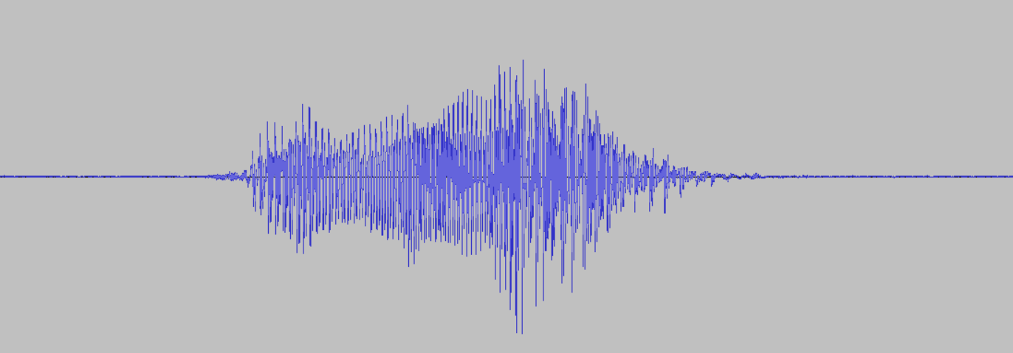
1 second audio sample
Model
Training

Slide 2
Fourier Transform
1 second audio sample (“hello”)
Fast Fourier Transform (FFT)
Amplitude
0
8 kHz
Frequency
Voice frequency range: 300 - 3400 Hz

Slide 3
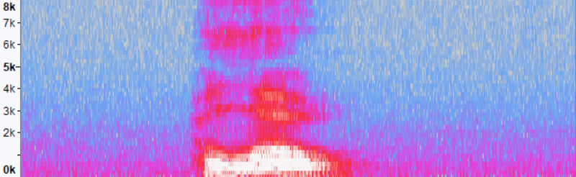
Fourier Transform
1 second audio sample (“hello”)
Spectrogram
Fast Fourier Transform (FFT)
Frequency
Amplitude
Time
0
8 kHz
Frequency
Voice frequency range: 300 - 3400 Hz

Slide 4
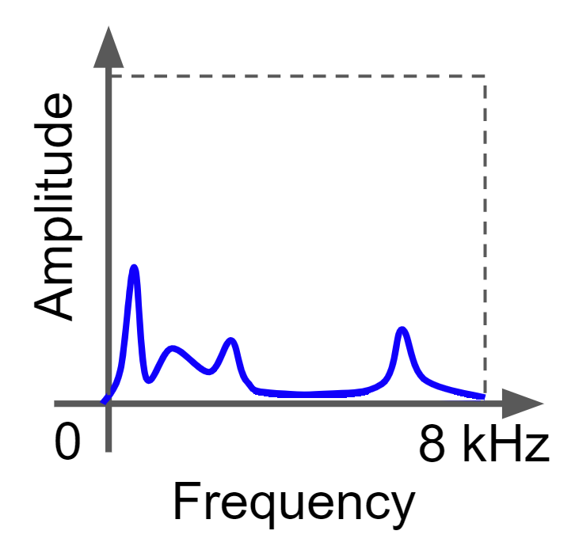
Nyquist-Shannon Sampling Theorem
f_{s} > 2B
f_{s} is the sampling frequency (Hz)
B is the highest frequency component (Hz)
Amplitude
Amplitude
0
8
16 kHz
0
8 kHz
Frequency
Frequency
Sampling rate: f_{s}
“Aliasing”
Nyquist frequency: ½ f_{s}

Slide 5
Nyquist-Shannon Sampling Theorem
f_{s} > 2B
f_{s} is the sampling frequency (Hz)
B is the highest frequency component (Hz)
Low-pass (“anti-aliasing”) filter
Amplitude
Amplitude
Amplitude
Filter
FFT
0
8
16 kHz
0
8
16 kHz
0
8 kHz
Frequency
Frequency
Frequency
Sampling rate: f_{s}
Sampling rate: f_{s}
Nyquist frequency: ½ f_{s}
Nyquist frequency: ½ f_{s}

Slide 6
Nyquist-Shannon Sampling Theorem
Audio Signal
Microphone
Analog Low-Pass Filter
Analog-to-Digital Converter (ADC) sampling
To microcontroller or recording device
Audio Signal
Microphone
Digital Low-Pass Filter
Analog-to-Digital Converter (ADC) sampling
To microcontroller or recording device

Slide 7
Nyquist-Shannon Sampling Theorem
Lesson: make sure what you’re recording is less than half the sampling frequency!

Slide 8
Mel Frequency Cepstral Coefficients (MFCCs)
Low freq. energy
1.063
0.407
0.229
0.164
-16.38
0
0.352
4.477
1
0.015
-5.061
2
1. Take FFT of window
0.012
High freq. energy
-0.749
3
0.007
-2.340
4
-6.093
5
2. Compute Mel-spaced filterbank energies
log()
3. Compute log of each value
-1.043
6
3.221
7
Amplitude
Mel
Frequency
Cepstral
Coefficients
4. Compute Discrete Cosine Transform
DCT
300
8000 Hz
Frequency

Slide 9
Mel Frequency Cepstral Coefficients (MFCCs)
MFCCs
12
-1.043
...
3
0.5467
2
0.0476
1
0.153
0
-1.173
0

Slide 10
Mel Frequency Cepstral Coefficients (MFCCs)
MFCCs
12
-1.043
-0.816
...
...
3
0.5467
0.442
2
0.0476
0.836
1
0.153
-0.671
0
-1.173
0.462
0
1

Slide 11


Mel Frequency Cepstral Coefficients (MFCCs)
“stop”
MFCCs
“hello”
12
-1.043
-0.816
...
-0.184
...
...
...
3
0.5467
0.442
...
-0.523
2
0.0476
0.836
...
0.185
1
0.153
-0.671
...
-0.248
0
-1.173
0.462
...
-1.218
0
1
48

